Slide 1
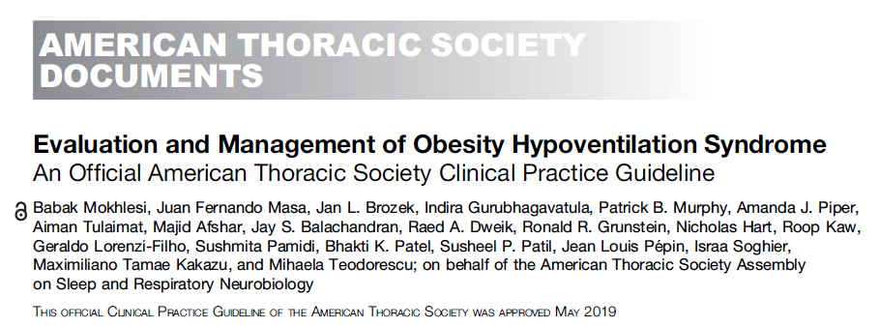
OHS as a model:
Definition:
BMI > 30 kg/m²
Sleep-disordered breathing
90% of patients with OHS have sleep apnea (AHI ≥ 5), 70% have severe sleep apnea (AHI ≥ 30). Other 10% have sleep hypoventilation
Awake hypercapnia (45 mmHg at sea-level; *42-43 mmHg at SLC)
Exclusion of other causes of hypoventilation
Problematic practically and philosophically
*insurers disagree
Notes:
Exclusion of other causes of hypoventilation
Obesity -> increased CO2 production and vent limitation from mass of chest wall and disadvantaged respiratory mechanics
“Other Causes”: Obstructive lung disease, neuromuscular / chest wall disease, things that suppress ventilatory drive (opiates), or causes of metabolic alkalosis (loop diuretics)
Likely routine to you all, but this is often botched in pulmonary and inpatient medicine.
Exclusion parameter
In research studies: A patient with mild COPD cannot have OHS. In reality – what do you do with a patient who has COPD so mild that it doesn’t cause OHS? Or, if it’s mild enough that it wouldn’t cause hypercapnia on it’s own? Open questions, problem with the paradigm.
“Exclusion of other causes of hypoventilation
Severe obstructive respiratory disease
Severe interstitial lung disease
Severe chest-wall disorders (eg, kyphoscoliosis)
Severe hypothyroidism
Neuromuscular disease
Congenital hypoventilation syndromes”

Slide 2
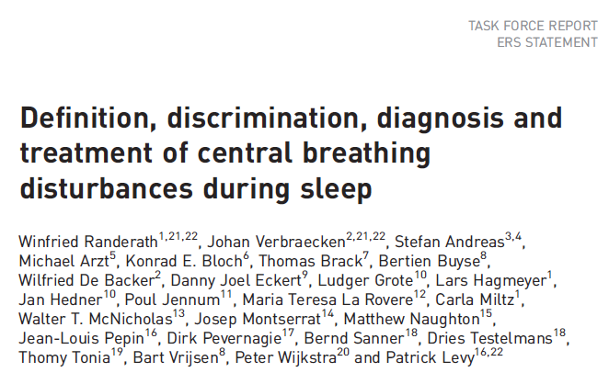
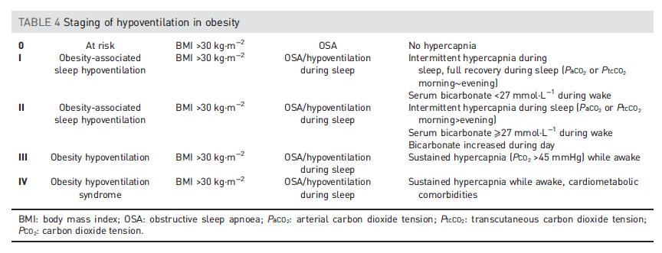
ERS 2018: Obesity-related hypoventilation paradigm
Notes:
Normal bicarbonate range should be: 23-30 Meq/L
https://cjasn.asnjournals.org/content/13/2/343
Normal elevation correction: per 1000m, 1.5 mEq/L lower

Slide 3
[ ] add summary of evidence behind the hco3 -> paco2 stuff
Why did the ERS propose that classification and what evidence supports it?

Slide 4
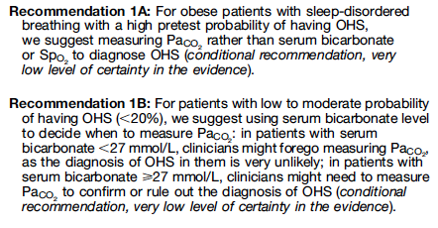
How good is HCO > 27 mEq/L at predicting PaCO2 > 45 mmHg?
3.7 times higher odds if above 27 mEq/L
0.18 times lower odds if below 27 mEq/L
Notes:
Normal bicarbonate range should be: 23-30 Meq/L
https://cjasn.asnjournals.org/content/13/2/343
Normal elevation correction: per 1000m, 1.5 mEq/L lower

Slide 5
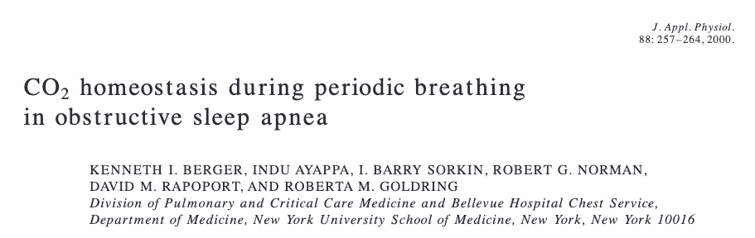
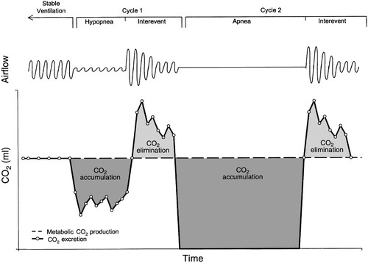
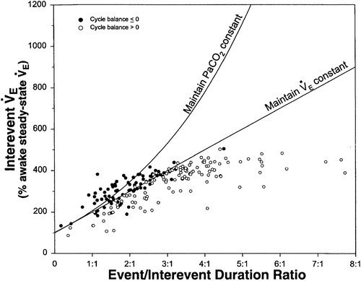
Pathophysiology
Notes:
Summary: as apnea duration increases and inter-event time decreases, the rate of ventilation between events required to maintain CO2 homeostasis increases.
(this explains why CPAP works in most OHS) https://doi.org/10.1152/jappl.2000.88.1.257
No relationship was seen between the CO₂ balance for each cycle and its interevent tidal volume or interevent ventilation. Positive CO₂ balance was not associated with a low interevent ventilation and occurred despite increased interevent ventilation to rates as high as 45 l/min.’
Thus, the authors infer the pathophysiology relates to **temporal** V/Q mismatching (as apposed to the usual **spatial** V/Q mismatch), rather than overall inability to compensate.
This is why they used Mixed Venous CO2 as a check – to ensure that temporal V/Q mismatching wasn’t compensated through changes in cardiac output
As the relative duration of the event increased (increasing ratios), there was a progressive increase in the interevent ventilation to a plateau at ratios >3:1. This plateau occurred at an interevent ventilation that was 450% of the awake steady-state value and reflects the maximum ventilation achieved by any patient during the interevent periods.
=➔ this would be different in someone who has pulmonary disease (or deconditioning) – limited in ability to increase
A model has been proposed where daytime hypercapnia can develop if sleep disordered breathing duration is sufficiently long or interapnea periods too short to restore ventilation and eucapnia (Berger et al., 2000). Berger and colleagues have suggested that gradual elevations in CO₂ occur over time since the ventilatory response to hypercapnia is insufficient compared to the rise in CO₂ which occurs during sleep.

Slide 6

Component Causes
COPD, Very Severe
BMI 45 kg/m2
AHI 50 event/hr
PaCO2 52 mmHg
PaCO2 50 mmHg

Slide 7
Component Causes
COPD, Very Severe
COPD, mod severe
AHI 50 events/hr
BMI 45 kg/m2
AHI 50 event/hr
PaCO2 52 mmHg
PaCO2 50 mmHg
PaCO2 50 mmHg

Slide 8
Component Causes
Component cause: if OSA weren’t there, the patient would not have the disease
COPD, Very Severe
COPD, mod severe
AHI 50 events/hr
COPD, mod severe
AHI 10 events/hr
BMI 45 kg/m2
AHI 50 event/hr
Vs
OSA is ‘component’ cause
PaCO2 52 mmHg
PaCO2 50 mmHg
PaCO2 40 mmHg
PaCO2 50 mmHg

Slide 9
Component Causes
COPD, Very Severe
COPD, mod severe
AHI 50 events/hr
COPD, mod severe
AHI 10 events/hr
COPD, mod severe
AHI 10 events/hr
Met. Alk loop diur
BMI 45 kg/m2
AHI 50 event/hr
Vs
Loop is ‘component’ cause
PaCO2 52 mmHg
PaCO2 50 mmHg
PaCO2 40 mmHg
PaCO2 50 mmHg
PaCO2 50 mmHg

Slide 10
Trial Data
Decent Epi
Few Cohorts
Some Epi
No tx data
Limited epi data
Trial Data
Decent Epi
COPD, Very Severe
COPD, mod severe
AHI 50 events/hr
COPD, mod severe
AHI 10 events/hr
Met. Alk loop diur
BMI 45 kg/m2
AHI 50 event/hr
PaCO2 52 mmHg
PaCO2 50 mmHg
PaCO2 50 mmHg
PaCO2 50 mmHg
Swap any combination of:
Muscular weakness
Obesity
Opiate use
Lung disease
Etc.

Slide 11
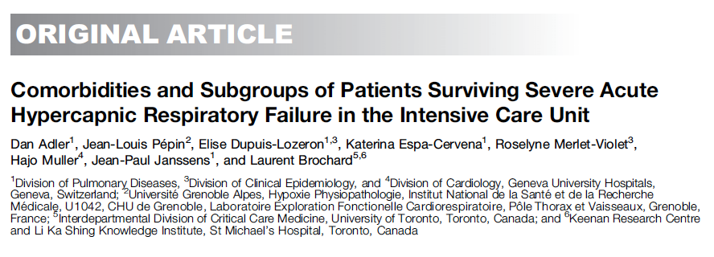
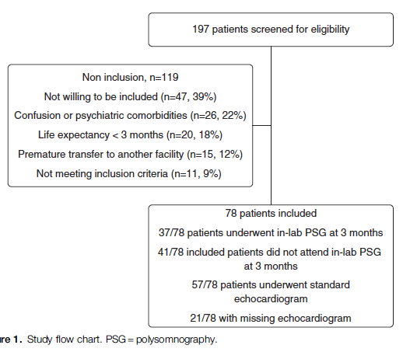
Component cause paradigm predictions:
If OSA is a common component cause, it ought to be present in more patients with hypercapnic respiratory failure than expected
[weakest level of evidence]
 | COPD (2/3) | No COPD (1/3)
Median [IQR] AHI | 31.9 [14.3, 45.6] | 66.0 [48.0, 83.8]
AHI > 5 present | 66% | 94%
AHI > 15 present | 51% | 81%
Notes:
N=78 patients, consecutive; Geneva. Recruited at ICU discharge after surviving PaCO2 over 6.3 kpa and requiring invasive or NIV. Exclude NM dz, iatrogenic, or with persisting confusion
21% had been hospitalized in the last yr for resp failure. 67% had COPD. 81 percent of patients without COPD were obese. 29% had OSA known (mostly untreated); 66% of those tested had mod-severe OSA. 51% had COPD&OSA. 44% had HFpEF, ~16%ish had pHTN
Patients who were not treated for OSA had higher readmissions (similar with others)

Slide 12
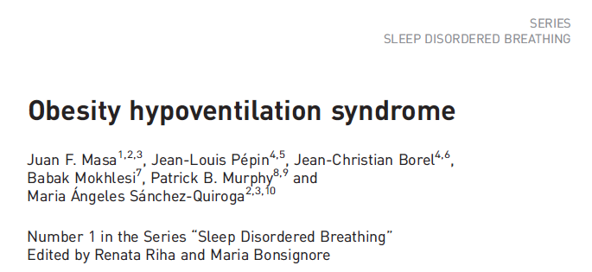
How common is hypercapnic respiratory failure?
Diagnosis occurs either at sleep/pulmonology referral, or acute decompensation (hospitalization, worse prognosis)
There is 0 data on prevalence of outpatient all-cause hypercapnia.
Why? Fewer data sources, ABGs are invasive, less morbid population
Based on indications for NIV prescription, OHS is probably most common
Fermi Estimate of Prevalence: 1 in 260 US adults
7.6% of adults US population BMI 40+
Rate of mod+ OSA in BMI 40+ = ~ 50%
Rate of OHS in mod+ OSA = ~10%

Slide 13

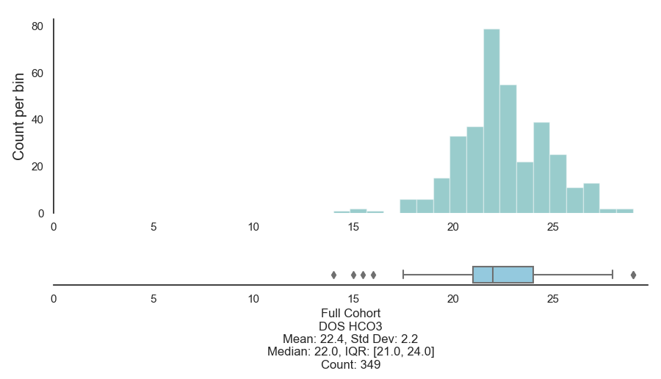
Cleveland Clinic; universal etCO2 before bariatric surgery
Prevalence: 68.4% by EtCO2 > 45 or HCO3 over 27.
[HCO3-] – day of surgery
However, Conrad Addison, Somya Mishra, Krishna Sundar, and I found only 59 of 222 (26%) of patients undergoing bariatric surgery had HCO3 over 25 mEq/L at U of U
-ATS SRN Abstract Award
Notes:
Bariatric surgery screening for OHS:
Tran, Wang, Gharaibeh, et al.: Bariatric Surgery Risk in Obesity Hypoventilation - A total of 1,718 patients undergoing polysomnography with end-tidal CO2 monitoring prior to bariatric surgery at Cleveland Clinic from September 2011 to September 2018 were included.”
Key Findings: “OHS prevalence was 68.4%. Unadjusted analyses revealed a 1.5% increased odds of OHS (1.01; 1.00-1.03) per 1-unit BMI increase, 1.7% (1.02; 1.01-1.02) per 1% increase in sleep time Sa_{O2} < 90%, 12% increase (1.12; 1.03-1.22) per 1-U increase in hemoglobin A1c, and 3.4% increased odds (1.03; 1.02-1.05) per 5-U increase in apnea-hypopnea index. The association of apnea-hypopnea index with OHS persisted after adjustment for age, sex, race, and BMI and its comorbidities (1.02; 1.01-1.04)”
“In a single-center retrospective study of morbidly obese patients admitted to the intensive care unit because of hypercapnic respiratory failure due to obesity hypoventilation, 75% had been erroneously diagnosed and treated for COPD, and 86% were being treated for congestive heart failure (36).”
“Marik and Desai reported that 8% of all admissions to a general ICU with acute-on-chronic hypercapnic respiratory failure met diagnostic criteria for OHS (22). “
Marik PE, Desai H. Characteristics of patients with the “malignant obesity hypoventilation syndrome” admitted to an ICU. J Intensive Care Med 2013;28:124–130.
BMI over 50+ - high rates
The CDC estimated that 7.6% of the adult U.S. population has a BMI ≥40 kg/m² (https://pubmed.ncbi.nlm.nih.gov/29922829/).

Slide 14
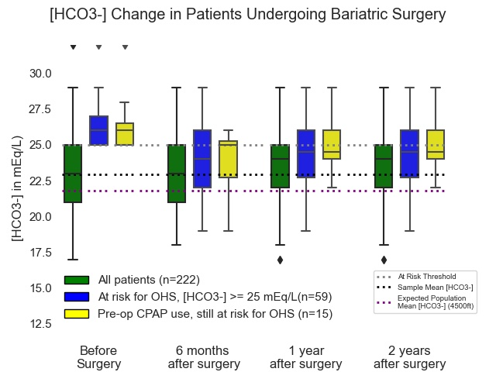

Slide 15
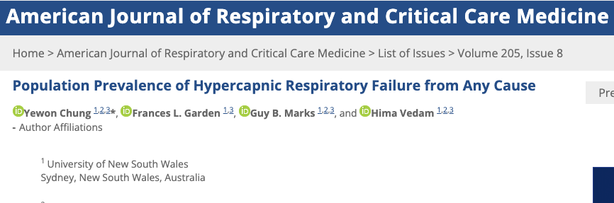
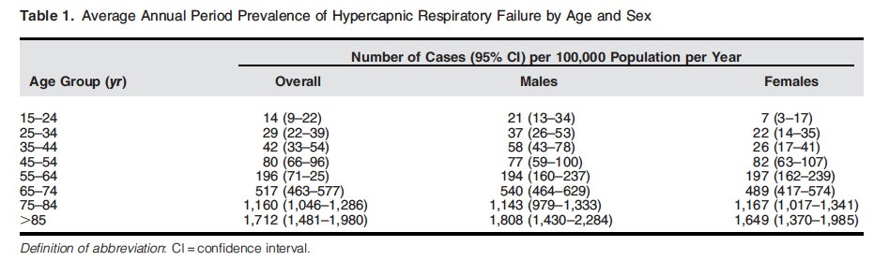
Prevalence of hypercapnic resp failure inpatient
Australia, 2013-2017. First ABG w/n 24h of presentation: PaCO2 45+ (min. est)
Excluded VBG, out-of-hospital cardiac arrest, traumatic injury, or sedation
163 per 100k person-year (~=PE)
“Compared to those aged 45 to 54 years, each successive decade of life conferred increases [risk] by 2.1, 6.2, 15.7 and 26.2 times”
Acidosis (acute) in 55%
Notes:
Ballpark, this is about similar to admission with Pulmonary Embolism.
(causal implication is slightly different)

Slide 16
Hypercapnia Trajectories
Between Assessments
Assessment 2
Increasing CO2
Assessment 1
Normal CO2 on labs
Normalization of Hypercapnia
Normal CO2 on labs
Hypercapnia on labs
Hypercapnia (not identified)
Hypercapnia on labs
Recurrent Acute Hypercapnic Respiratory Failure (subtle diff. from chronic)
Acute Hypercapnic Respiratory Failure
Transient Hypercapnia? (hard to capture, hypothetical – opiates?)
Chronic Hypercapnic Respiratory Failure
Common: COPD, UT?
Common: OHS
Notes:
Do we know much about the relative proportion of these arrows? No. Probably Recurrent Acute and Acute = over-represented by current methods to identify. Yellow types may be most of what gets diagnosed in sleep clinic (vs hospitalization)
Roughly 30% of OHS patients identified at acute decompensation based on: 83 Priou P, Hamel JF, Person C, et al. Long-term outcome of
noninvasive positive pressure ventilation for obesity hypoventilation
syndrome. Chest 2010; 138: 84–90.
Acute Hypercapnia well tolerated, much research into acute management exists
For COPD – Green vs brick arrows … in HOT-HMV, roughly ¼ of patients who met inclusion criteria at discharge were no longer hypercapnic after 2-4 weeks. Not known how frequently resolution is for other causes
For OHS overall, roughly 50/50 present as the green arrow and the yellow arrow. The green arrow has a much worse prognosis than the yellow arrow.
In UT: more blue and orange arrow than green and yellow because hypoxemia is apparent.

Slide 17

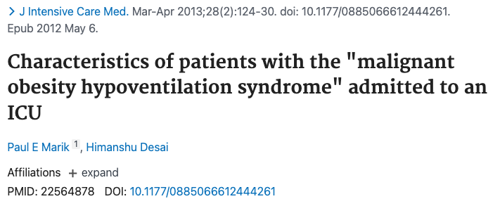
Frequency of missed diagnoses: Inpatients
2005, Denver. Consecutive admissions of patients with BMI over 35. Excluded COPD or prior lung resection. 31% had PaCO2 over 45*. In subgroup of BMI over 50, 48% did.
Only 23% diagnosed with OHS, 13% commenced on PAP after discharge.
Reviewed all admissions with PaCO2 over 45 and BMI over 40.
75% misdiagnosed with OHS despite not having evidence of obstruction on PFTs
Notes:
30 Nowbar S, Burkart KM, Gonzales R et al. Obesity-associated hypoventilation in hospitalized patients: prevalence, effects, and outcome. Am J Med 2004;116:1-7
Nowbar: Of 277 patients with a BMI ≥35 kg/m² admitted to an inpatient medical service, Nowbar and colleagues⁴ found that 31% met criteria for OHS. when a subgroup of patients with BMI greater than 50 kg/m² was examined, OHS was found in 48%. Of particular concern, (though likely representative of many hospitals), effective therapy for hypoventilation was only instituted in 13% of these patients.
Predicting OHS
32 Bulbul Y, Ayik S, Ozlu T, Orem A. Frequency and predictors of obesity hypoventilation in hospitalized patients at a tertiary health care institution. Ann Thorac Med 2014;9:87-91.
45. Javaheri S, Simbartl LA. Respiratory determinants of diurnal hypercapnia in obesity hypoventilation syndrome. What does weight have to do with it? Ann Am Thorac Soc. 2014;11:945-950

Slide 18
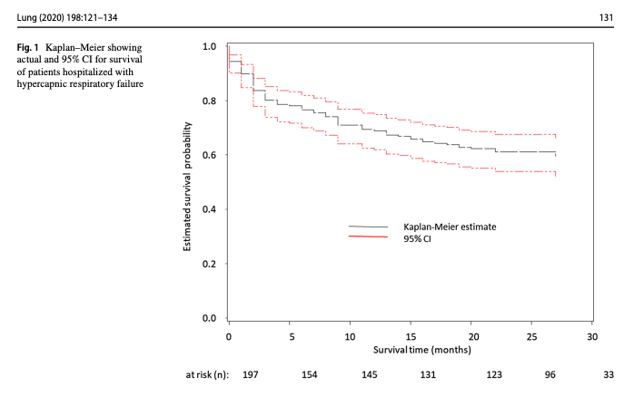
Notes:
[ ] add mortality info
ICD 10 diagnostic codes [J96.02 (acute HRF), J96.22 (acute and chronic respiratory failure with hypercapnia), J96.92 (respiratory failure unspecifed with hypercapnia), J96.12 (chronic respiratory failure with hypercapnia), E66.2 (morbid obesity with hypoventilation)]
https://link.springer.com/content/pdf/10.1007/s00408-019-00300-w.pdf UVM
202 patients admitted with acute hypercapneic resp failure
Identified by ICD code.
Comorbs: 29% CHF, 24% OSA, 6% OHS, 46% COPD, 10% Asthma
Admission reason: 50% resp failure, 11% pneumonia, 23% AECOPD, 5% overdose, 12% sepsis, 29% cardiac disease
23% readmission within 30 days; higher with peripheral vascular disease, active smoking, ILD and Bronchiectasis; increased with compensation (bicarb 40-49 vs 20-29)

Slide 19
Notes:
Inclusion criteria: Admitted, 18+
ABG showing PaCO2 over 45 and pH 7.35-7.45 during 2018. N=491
44% had multiple admissions w/n the year
44.2% mortality over a median of 592 days
Manual review of 40 patients with 0 competing metabolic proceses.

Slide 20
What proportion of hypercapnia is caused by each etiology? Unknown Do these mixed causes of hypercapnia benefit from the same therapy? Unknown
?
COPD, Very Severe
COPD, mod severe
AHI 50 events/hr
COPD, mod severe
AHI 5 events/hr
Met. Alk loop diur
BMI 45 kg/m2
AHI 50 event/hr
PaCO2 52 mmHg
PaCO2 50 mmHg
PaCO2 50 mmHg
PaCO2 50 mmHg
Swap any combination of:
Muscular weakness
Obesity
Opiate use
Etc.

Slide 21
How is the current literature identifying hypercapnia?
Diagnostic Code-Based
Admitted (ICU or floor) with one of the following diagnostic codes:
J96.02 (acute hypercapnic respiratory failure)
J96.22 (acute and chronic respiratory failure with hypercapnia)
J96.92 (respiratory failure unspecifed with hypercapnia)
J96.12 (chronic respiratory failure with hypercapnia)
E66.2 (morbid obesity with hypoventilation)

Slide 22
Currently, how is hypercapnia identified?
Lab-Based
Admitted to hospital (Floor or ICU) with ABG showing PaCO2 over 45 mmHg and pH 7.35-7.45

Slide 23
Currently, how is hypercapnia identified?
Lab and procedure code-Based
Admitted to the ICU
PaCO2 greater than 47.25 mmHg
Procedure code for non-invasive ventilation or invasive mechanical ventilation initiation

Slide 24
Project 1: Hypotheses Brian Locke, Krishna Sundar, Jeanette Brown, Ramikiran Gouripeddi
The methods used in prior studies of hypercapnic respiratory failure identify different patients
Hypothesis 1: the sensitivity (aka recall) and positive predictive value (aka precision) for both billing code- and procedural code-based identification of hypercapnic respiratory failure will be below 80%, when compared to blood gas-based identification as the reference standard.
The populations identified by differ in risk for outcomes of interest, which hampers interpretation of these studies.
Hypothesis 2: The distribution of age, ethnicity, BMI, Elixhauser comorbidity score, and frequency of coexisting diagnoses (OSA, opiate use disorder, COPD, CHF, and neuromuscular disease) will differ between the cohorts identified by each method.
Notes:
Will discuss why not Se and Sp
Will discuss why blood gas taken as a reference standard.
Hypothesis 2: The distribution of age, ethnicity, BMI, Elixhauser comorbidity score, and frequency of coexisting diagnoses (OSA, opiate use disorder, COPD, CHF, and neuromuscular disease) will differ between the cohorts identified by each method.

Slide 25
Data source:
69 million MRNs; ~50 academic medical centers (including U of U)
De-identified, patient-level data (not PHI, though recommended to be treated as such)
Missing Data?
Data Available | Data unavailable
Demographics Diagnosis Medications Procedures - what procedures were done. E.g. sleep study code Labs Cancer registry (NAACCR) Allergies | Some notes* Diagnostic reports DICOM image objects Providers Departments/clinics

Slide 26
We requested patient level data from all records with an inpatient encounter and any of:
Diagnostic code for respiratory failure
Included all types
Arterial Blood gas with hypercapnia (45 mmHg+)
Procedure code for initiation or management of NIV or IMV
N=~800,000 patients.
Notes:
(bolded = correct classifications for hypercapnia; non-bolded = incorrect, but likely common, misclassifications of hypercapnia)
J96.12 (chronic respiratory failure with hypercapnia),
J96.02 (acute hypercapneic respiratory failure),
J96.22 (acute and chronic respiratory failure with hypercapnia),
J96.92 (respiratory failure unspecified with hypercapnia),
E66.2 (morbid obesity with hypoventilation)
J96 Respiratory Failure, not otherwise specified
J96.00 Acute Respiratory Failure, unspecified whether hypoxia or hypercapnia
J96.01 Acute respiratory failure, with hypoxia
J96.1 Chronic Respiratory Failure
J96.10 Chronic Respiratory Failure, unspecified whether hypoxia or hypercapnia J96.11 Chronic Respiratory Failure with hypoxia
J96.2 Acute and Chronic Respiratory Failure
J96.20 Acute and Chronic Respiratory Failure, unspecified whether hypoxia or hypercapnia
J96.21 Acute and Chronic Respiratory Failure, with hypoxia
J96.90 Respiratory Failure, unspecified whether with hypoxia or hypercapnia (most common in TrinetX)
J96.91 Respiratory Failure, unspecified with hypoxia
Specific Procedure Codes:
Assistance with Respiratory Ventilation, 0-24 hours; 24-96 hours; and longer than 96 hours
Management of non-invasive ventilation
Respiratory Ventilation, 0-24 hours; 24-96 hours; and longer than 96 hours
Ventilator Management
Ventilation Assist and Management.. initial; first day; and subsequent day
ICD-10: Mechanical Ventilation - 5A1935Z, 5A1945Z, 5A1955Z
Specific Blood gas codes:
LOINC 2019-8 Carbon Dioxide [ Partial Pressure ] Arterial Blood over 45
LOINC 2026-3 Carbon Dioxide, total [ Moles/Volume] in Arterial Blood over 45
LOINC 32771-8 Carbon Dioxide [ Partial Pressure] adjusted to patient’s actual temperature in arterial blood over 45
LOINC 11557-6 Carbon Dioxide [ Partial Pressure] in Blood

Slide 27
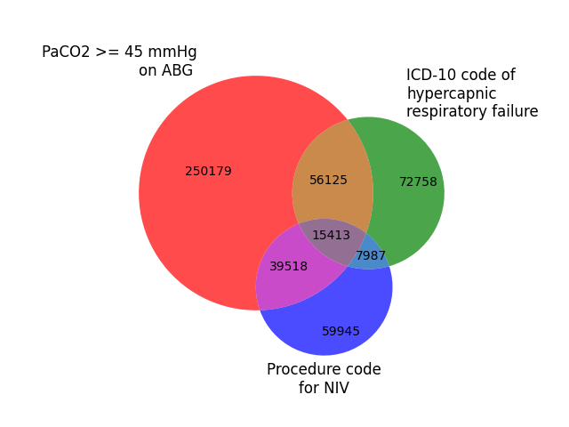
Preliminary Results
Using TriNetX Embedded Tools*
ICD Group:
Relative sensitivity (vs ABG): 19.8%
Positive Predictive Agreement (vs ABG): 47.0%
NIV Group:
Relative sensitivity (vs ABG): 15.2%
Positive Predictive Agreement (vs ABG): 45.2%
Notes:
Why start with inpatients with Hypercapnia?
Easier ascertainment
Informed presence bias
Labs
Data sources
Higher morbidity

Slide 28
Preliminary Results
 | ABG Group | ICD Group | NIV Group
Age | 62±18 | 65±16 | 62±17
% Female | 46% | 51% | 42%
% white | 66% | 71% | 65%
% Black | 18% | 19% | 17%
BMI | 30.4±8.3 | 33.1±10.3 | 29.1±8.2
% with CHF | 37% | 30% | 19%
% with COPD | 31% | 30% | 14%
% Opiate UD | 6% | 3% | 3%
% Sleep Apnea | 23% | 24% | 10%

Slide 29
Implications:
For accurate determination of
Frequency of different comorbidities or causes
Morbidity and mortality associated with hypercapnia
Who should be included in studies to determine benefit from treatment
... method of patient identification likely matters
Interpretability of current research could be improved using standard case definitions

Slide 30
How should we identify these patients (for studies)? Next Steps
What should the reference standard be?
Does transient elevation PaCO2 after opiate administration imply respiratory failure?
Technically yes, but the implication of the diagnosis is much different
How much heterogeneity should the definition have?
Current PaCO2 threshold (45mmHg at sea level; 42-3 mmHg in SLC) are arbitrary (No epidemiologic data to support).
Different threshold by cause (NIV in COPD 52 mmHg; 45 mmHg other)
Informed presence bias: people who have information in the EHR differ from those who do not.
Who should get an ABG?
Can we use HCO3-, VBG, or other data sources to identify patients?
Notes:
Informed presence bias: people who have information in the EHR differ from those who do not.
What would the ABG have shown, if it were checked? Hard to predict
EHR Computable Phenotype: an algorithm to classify patients based on the information present in the EHR
EHR Computable phenotype for Hypercapnic Respiratory Failure?
What should the reference standard be?
Physician adjudication? Chart Review
Based on some outcome measure: ie, risk of mortality or readmission
Uses:
Epidemiology: Prevalence Estimates
Conditional Probabilities for Diagnosis
Clarification of burden of disease; coverage of treatment modalities
Cohort or Trial enrollment
Prediction of patients in need of blood gas assessment or capnography

Slide 31
5 Takeaways:
HCO3- elevation may be part of the disease spectrum and a useful screen for OHS. Applicability to hypercapnia as a whole is unknown
OSA is common in patients with hypercapnic respiratory failure of any cause, and may contribute to its development as a component cause.
Hypercapnia is frequently undiagnosed. When diagnosed, it’s usually in sleep/pulm clinic or at hospitalization.
Hospitalization with hypercapnia is about as common as PE. Readmission rates are higher than MI, pneumonia, and COPD exacerbations. Mortality rates are high.
Better epidemiologic definitions are to better characterized all-cause hypercapnia, particularly when multiple component causes contribute.
[ ] questions about what to do predominated – perhaps add more as a call to action (ie. this is common, morbid, but we don’t know)

Slide 32
Questions? Suggestions? Comments?
Brian.Locke@hsc.Utah.edu
Krishna.Sundar@hsc.Utah.edu

